Slide 1

GreenMate
Christopher Huynh
Chen-Yu Chang
Yiqin Zhang
Hanming Wang
Michael Harkess
Samarah Uriarte

Slide 2
Team – Green Dolphin
Christopher Huynh --- Project Lead
Chen-Yu Chang --- Specification Lead
Yiqin Zhang --- Interface Lead
Hanming Wang --- Technical Lead
Michael Harkess --- Technical Lead
Samarah Uriarte --- Documentation Lead

Slide 3
App Purpose
To encourage people to be more eco-friendly, we created an application that records the walking steps, the distance traveled by bicycle, and the recycling history. These actions will reward the users by allowing them to gain some points, and these points then change the bear character’s state.

Slide 4
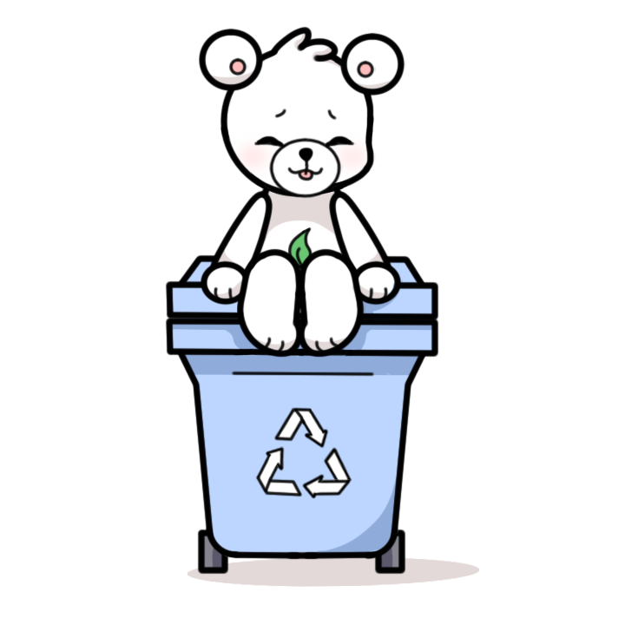
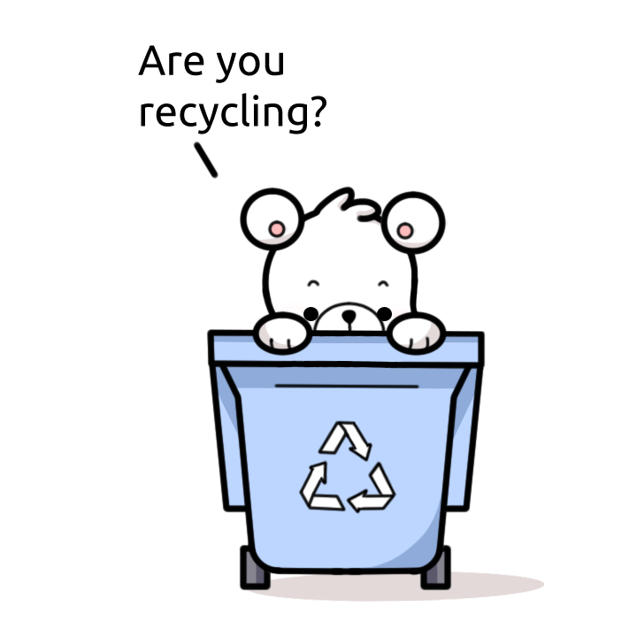



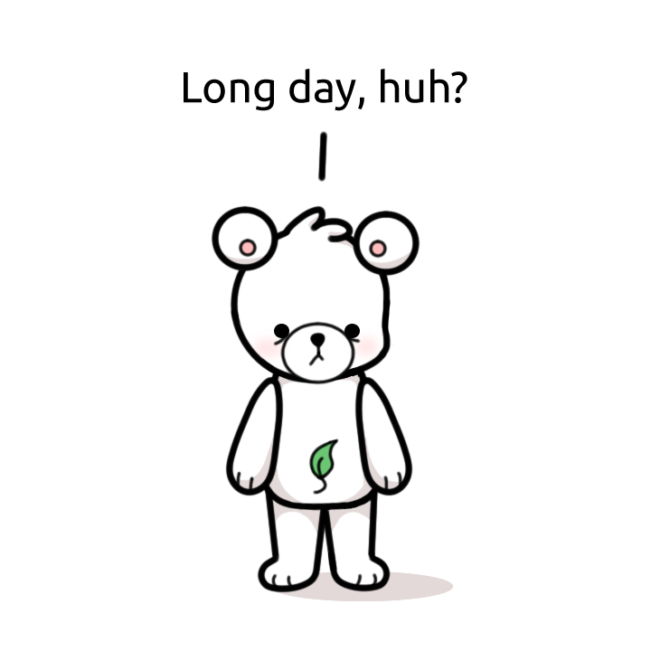

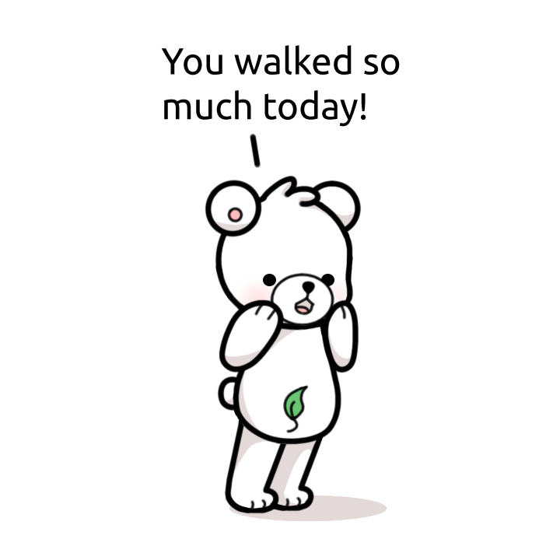
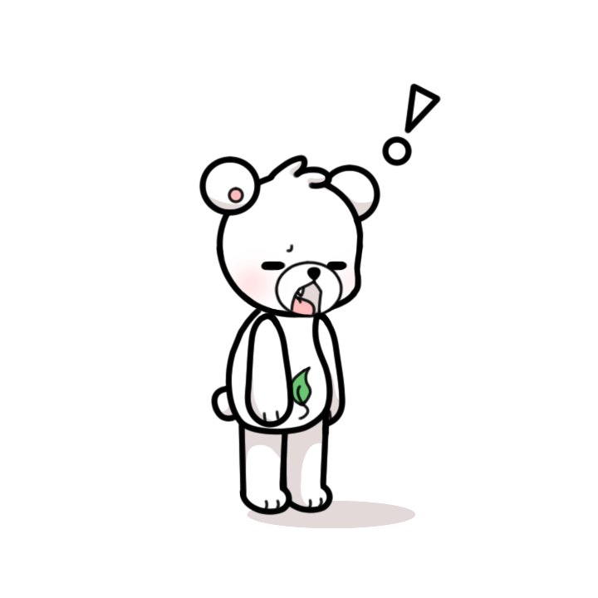
Main Character-Bear
This character, drawn by Samarah, will change into different stages when sensing the user’s situation.

Slide 5
Software Architecture
Login Activity
Home Activity
Sensor Filter
Step Listener
Step Detector
Step Calculation
Maps Activity
GPS
Point System
Recycle Database
Recycle Rules
UI Design

Slide 6
Diagram
UI Design
Login Activity
Work Out
Recycle
Home Activity
Maps Activity
Points System
Step Counter
Points System
Recycle Rules
Recycle Database
GPS
Sensor Filter
Step Detector
Step Listener
GPS
Step Calculation

Slide 7
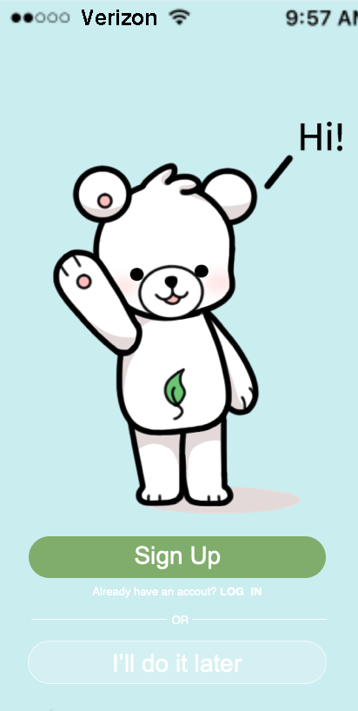
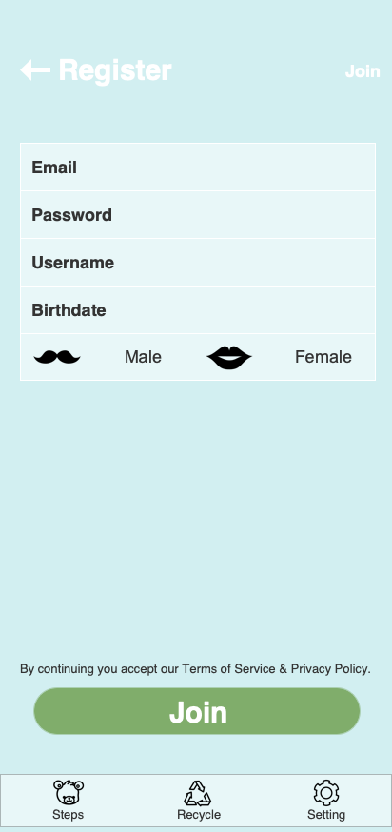
Login Activity
This function allows the user to create their own account and save all the records in it.

Slide 8
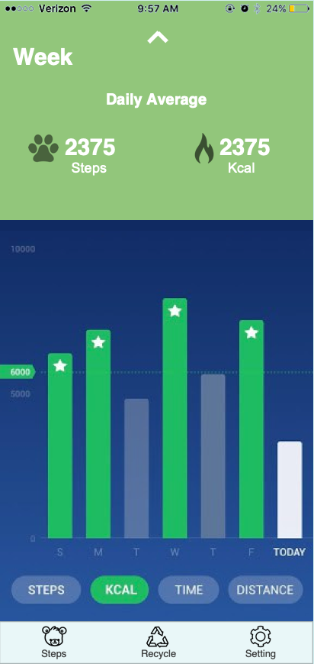

Home Activity
This function combines several other functions detected by the step counter. This module employs a step listener, a step detector, a sensor filter, and a step calculation to record the distance a user walks or bikes.

Slide 9
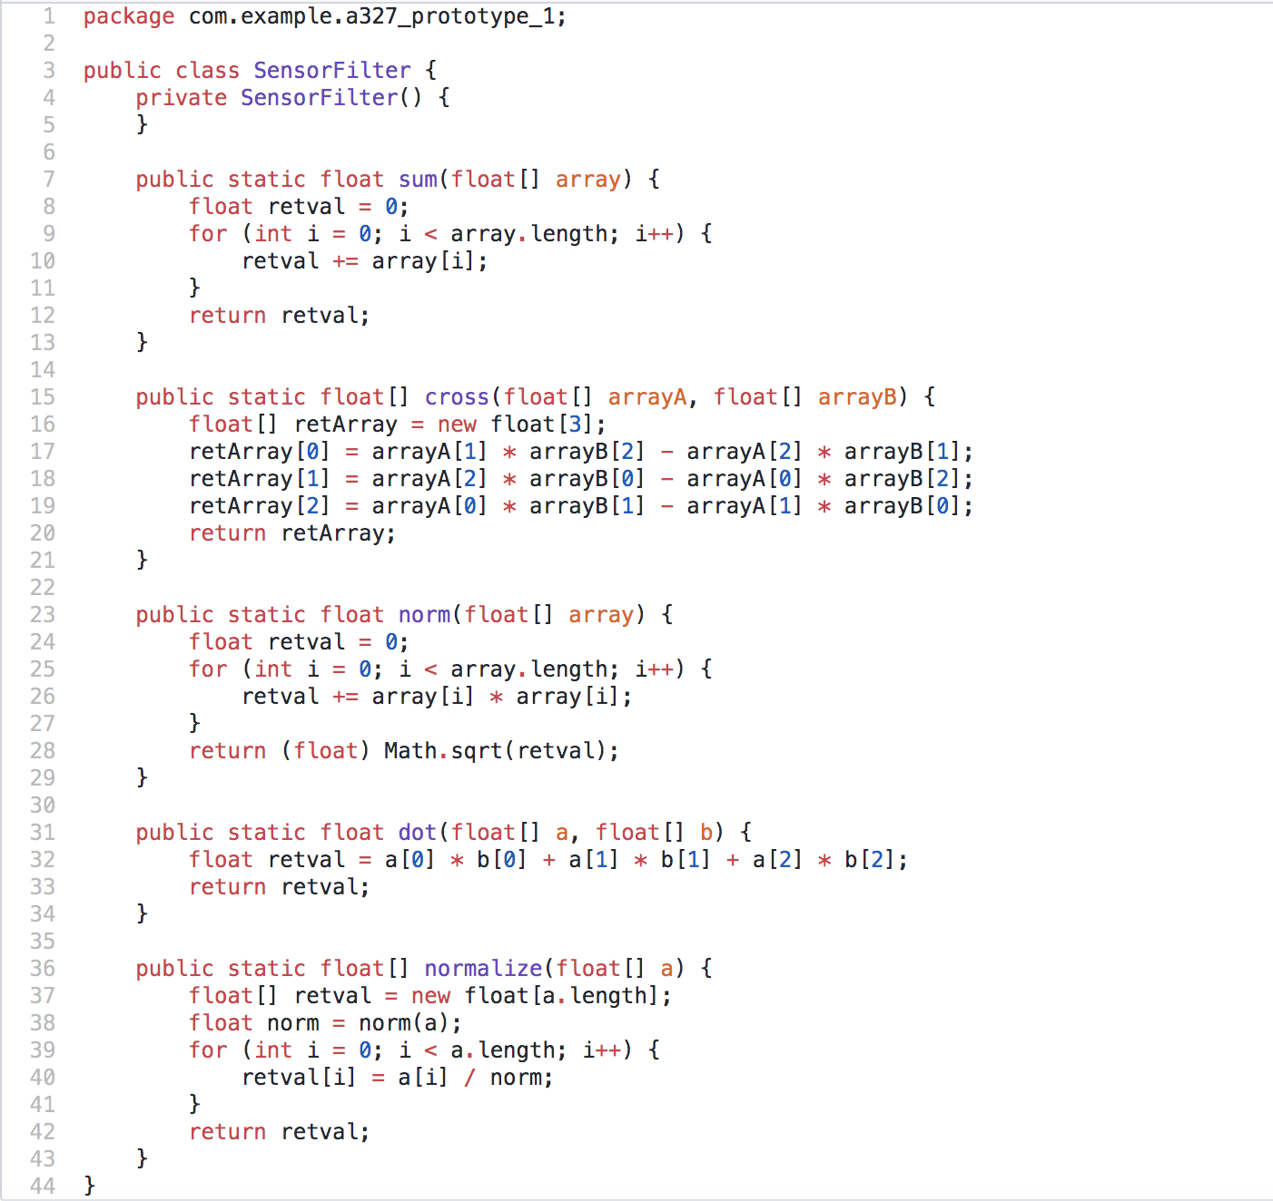
Step Counter - Sensor Filter
This is a class that operates an algorithm to filter out the values that has an approximation of steps by the sensor installed in the phone.

Slide 10
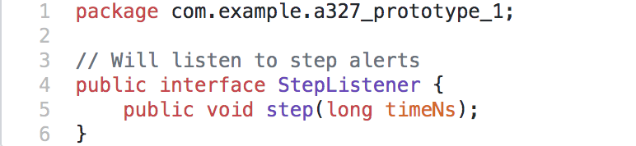
Step Counter - Step Listener
This interface will listen to alerts about steps being detected. This is a subsystem used in the Home Activity module.

Slide 11
Step Counter - Step Detector
This function creates a class that accepts the updated data from accelerometer sensor and deploys the filter to detect if a step was covered by the user. It is operated inside the Home Activity.

Slide 12
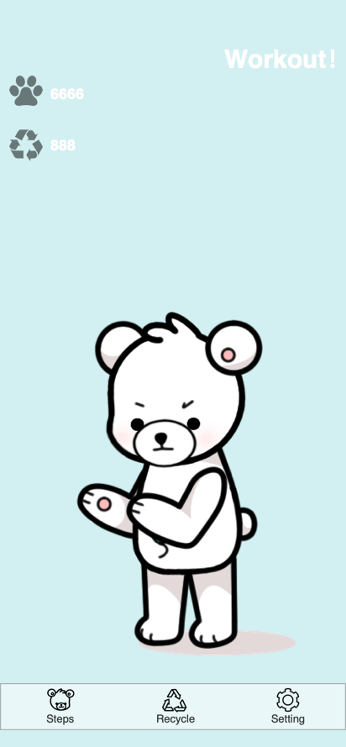
Step Counter - Step Calculation
This function records the initial position to the final location in longitude and latitude. Then, we can calculate out the approximate distance the user goes and convert into points. It is cooperated with the GPS to track the routine.

Slide 13
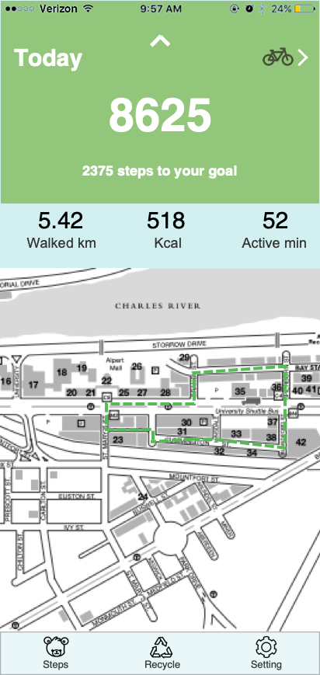
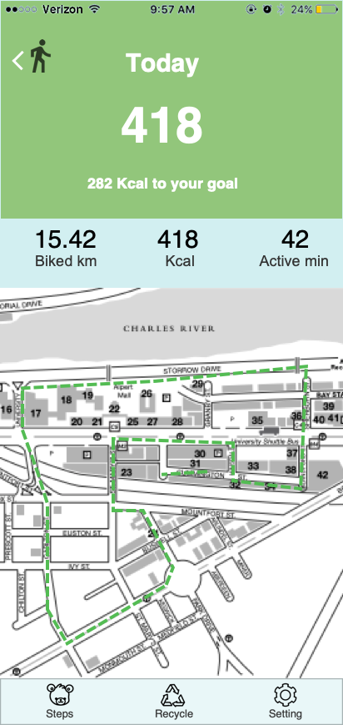
Maps Activity
This function manipulates the map once, allowing us to add markers, lines, and listeners. It provides us the tool of tracking the routine of the user’s walk or bike ride.

Slide 14
GPS
This function uses two key coordinates, latitude and longitude, to know the user’s exact position. The implementation of distance tracker applications and location tracker apps are features of the GPS function. GPS is used both in work out and recycling functionality.
Work out: location changes and map displays
Recycle: pinpoint the location of the recycling station

Slide 15
Point System
This system operates through user input in the form of steps or number of objects recycled. The user’s point amount falls into certain ranges and changes the bear character’s state.

Slide 16
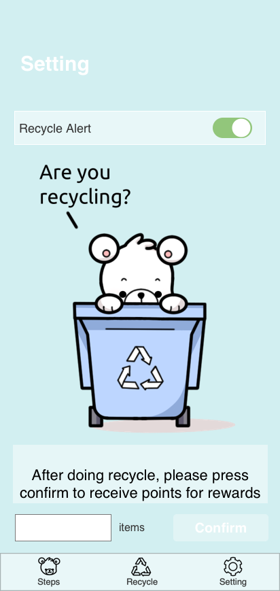
Recycle Database
The database includes the records of the user’s recycling, and the instructions are provided about the categories and whether it can be recycled or not. It is connected with the point system to cooperate with the input the user gave.

Slide 17
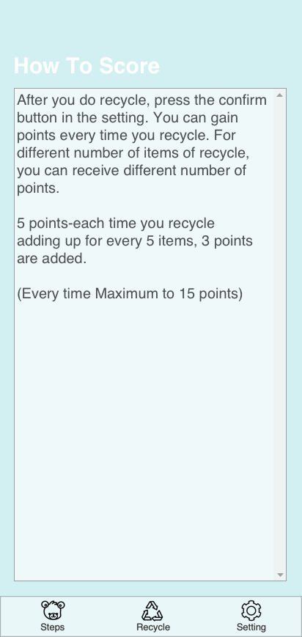
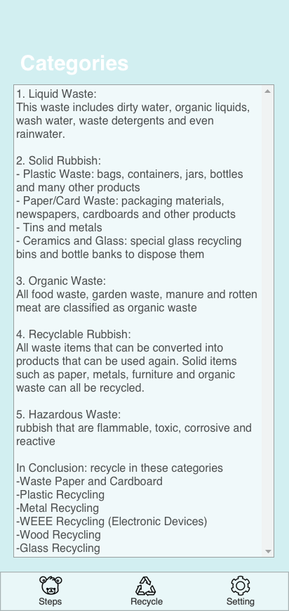
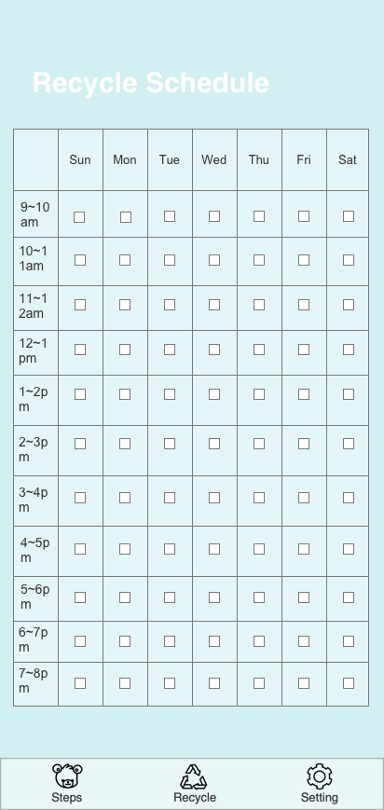
Recycle Rules
This function provides the general information on what to recycle, and the schedule of the recycling time.

Slide 18
UI Design
The app’s UI design is the interface that the user will directly see. All the buttons, scrolls, and flips are designed from Android Studio.

Slide 19
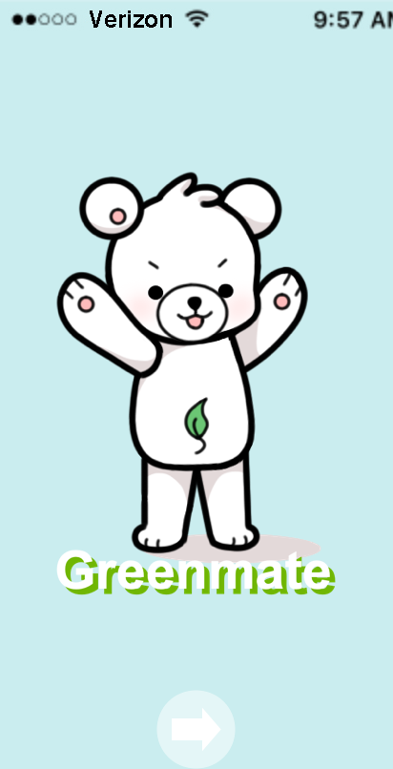
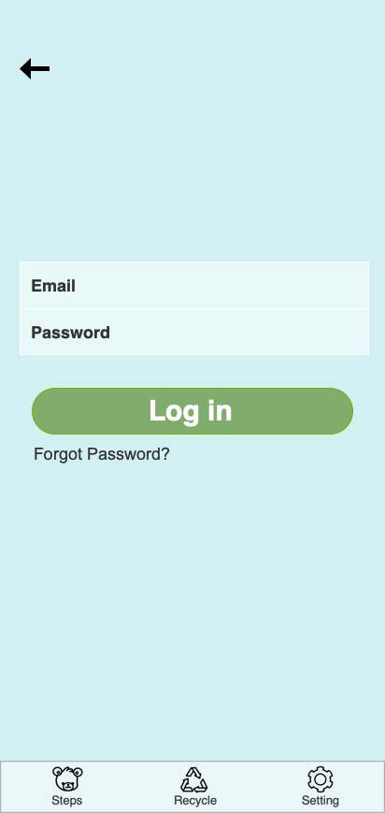
UI Design

Slide 20
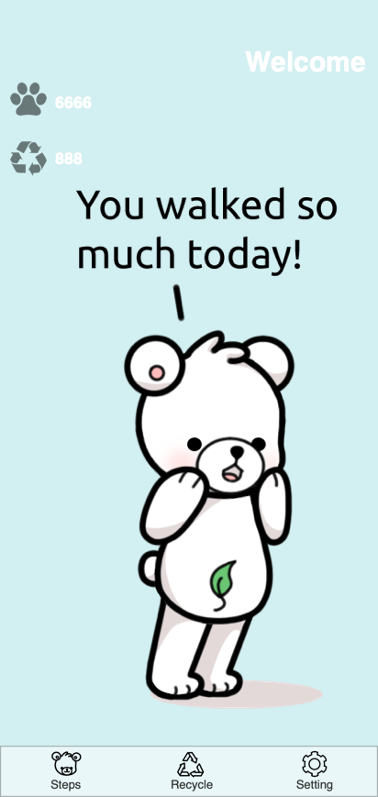
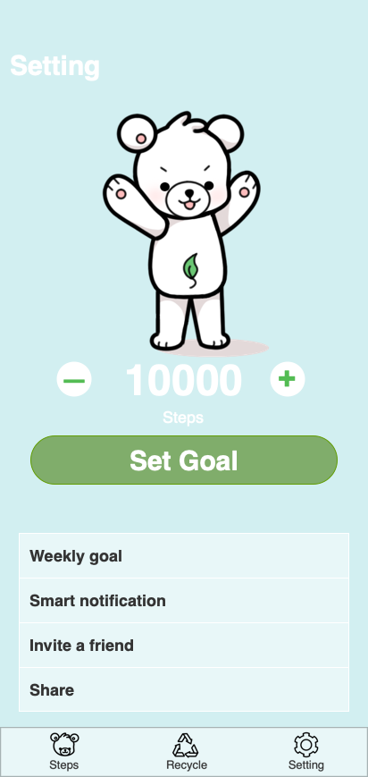
UI Design

Slide 21
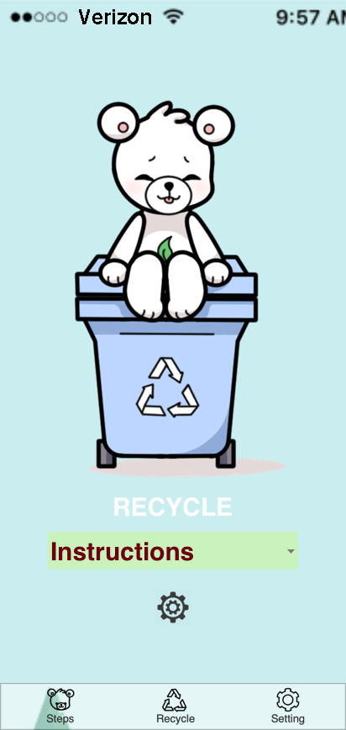
UI Design

Slide 22
Future Development
To work further on the app, we can cooperate with other companies for exchanging the points in the app to rewards, such as coupon, gift cards, or free products.

Slide 23
Reference Sites
https://www.tukuppt.com/muban/pgbvzoxe.html
https://www.zsc5.com/beijing/katong/4106.html
http://www.mmonly.cc/wmtp/wmbj/135759_4.html
http://www.abckids.com.tw/newsdetail_tw.php?id=123494
http://www.sahandcrm.com/Home/Blog
https://www.rev.com/blog/phone-recorder-how-to-record-call-iphone
http://www.lucemorker.com/blog/introduction-to-software-architecture
https://www.iconfinder.com/icons/2352275/design_interface_mobile_ui_ux_icon
https://www.iconfinder.com/icons/1173372/architecture_business_city_development_future_sustainable_town_icon

Slide 24
Thank You

